Slide 1




NEXT GEN EMPLOYABILITY PROGRAM
Creating a future-ready workforce
Team Members
College Name
Student Name : V. Deva dharshini
Student ID : 623521104008
6235 - AVS College of Technology

Slide 2

CAPSTONE PROJECT SHOWCASE
Project Title
Building Bus Reservation System using Python and Django
Abstract | Problem Statement | Project Overview | Proposed Solution | Technology Used | Modelling & Results | Conclusion

Slide 3
Abstract
The Bus Reservation System (BRS) is a web-based application developed using Python and Django framework.
Aimed at facilitating the booking and management of bus tickets, providing convenience and efficiency to users.
Key features include user registration/authentication, bus and route management, seat reservation, payment integration, and reservation management.
Source :

Slide 4
Problem Statement
Existing bus reservation systems suffer from inefficiency and lack of convenience, posing challenges for both passengers and bus operators.
Booking processes are often complex and time-consuming, leading to inconvenience for passengers and potential loss of business for operators.
Passengers face difficulty in accessing accurate and up-to-date information about available buses, routes, and seat availability, hindering effective travel planning.
Source :

Slide 5
Project Overview
The Bus Reservation System (BRS) is a web-based application developed using Python and Django framework, aiming to streamline the booking process and enhance the management of bus reservations. Here's an overview of the project:
Objective: The primary goal of the project is to create a user-friendly and efficient platform for booking bus tickets, providing accurate information to passengers, and empowering bus operators with effective management tools.
Source :

Slide 6
Proposed Solution
Develop a comprehensive Bus Reservation System (BRS) using Python and Django framework to streamline the booking process and enhance reservation management.
Key Components:
User Management
Bus and Route Management
Reservation Management
Admin Dashboard
Source :

Slide 7


Technology Used
Front-end
Back-end
Source :

Slide 8
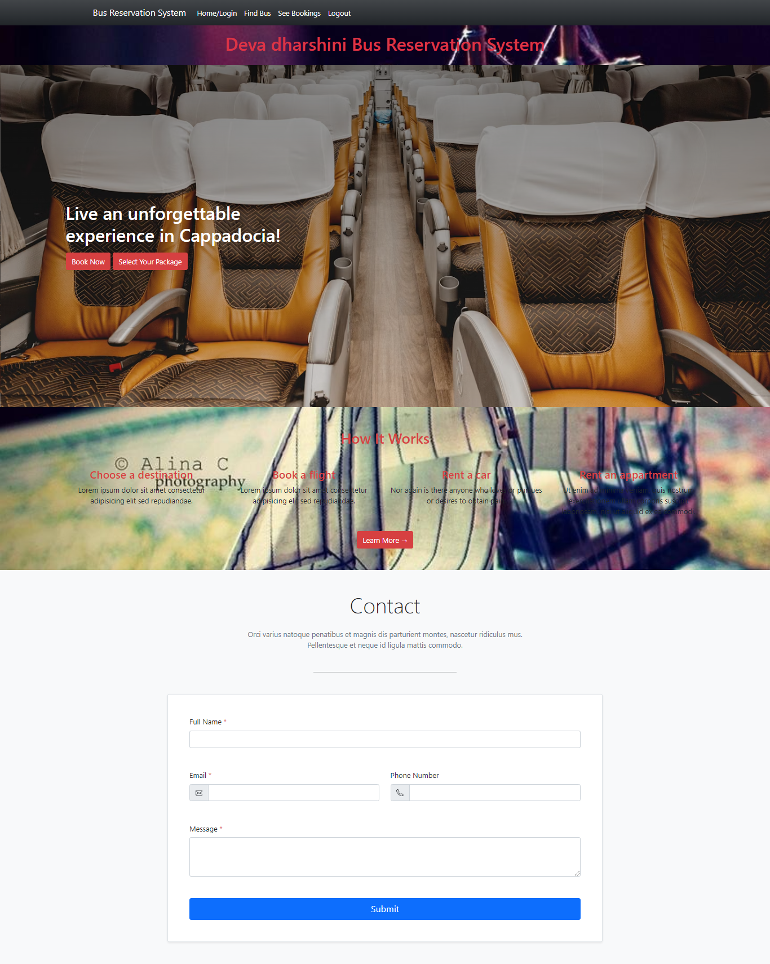
Modelling & Results
Source :

Slide 9
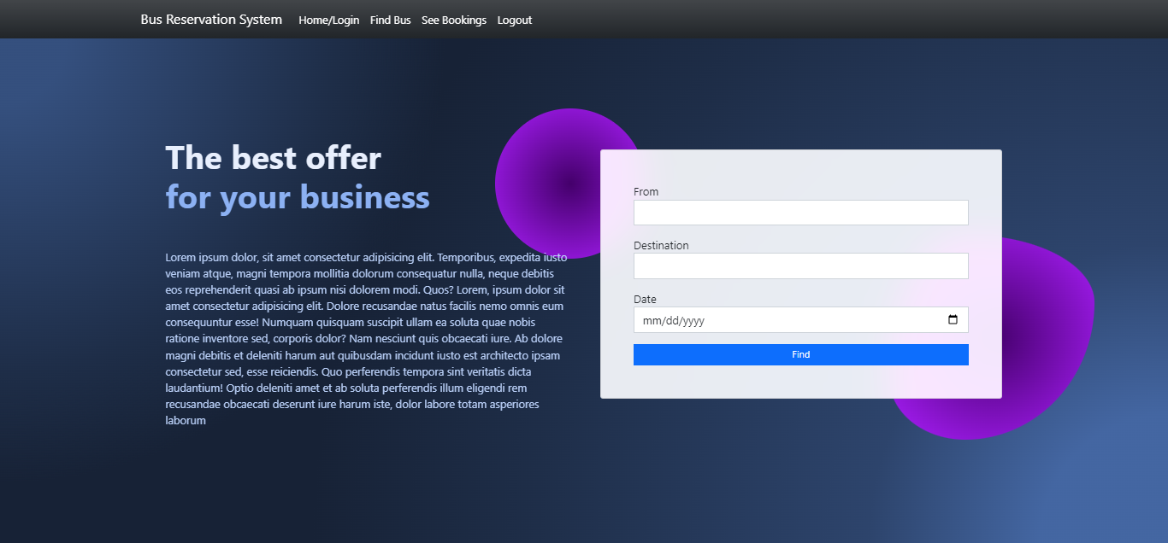
FIND BUS

Slide 10
HOME PAGE

Slide 11
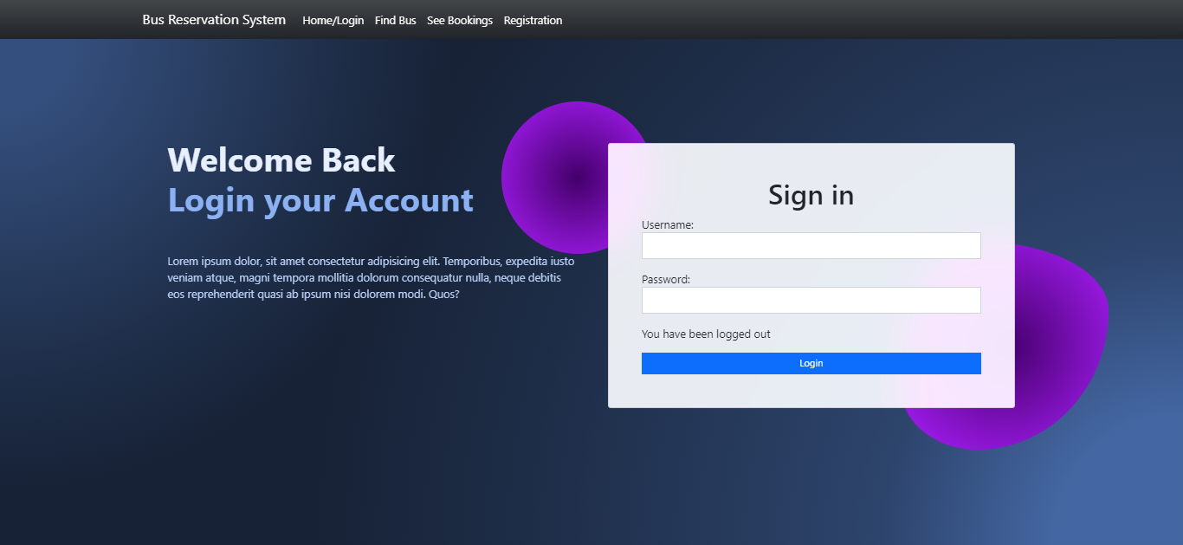
LOGIN PAGE

Slide 12
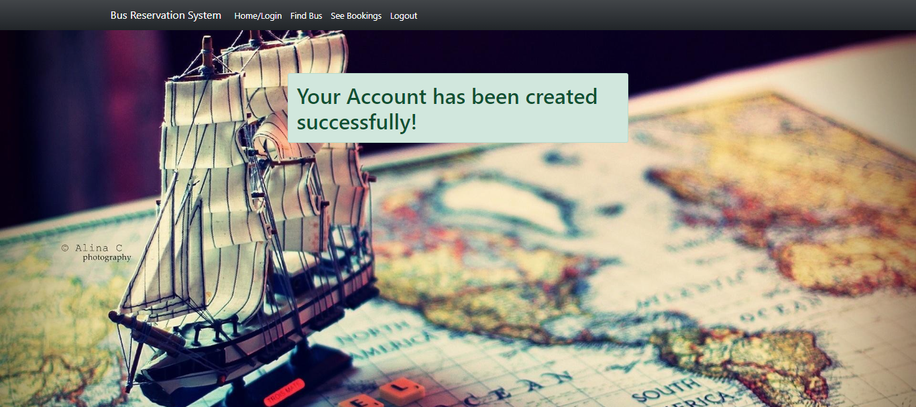
THANKS PAGE

Slide 13
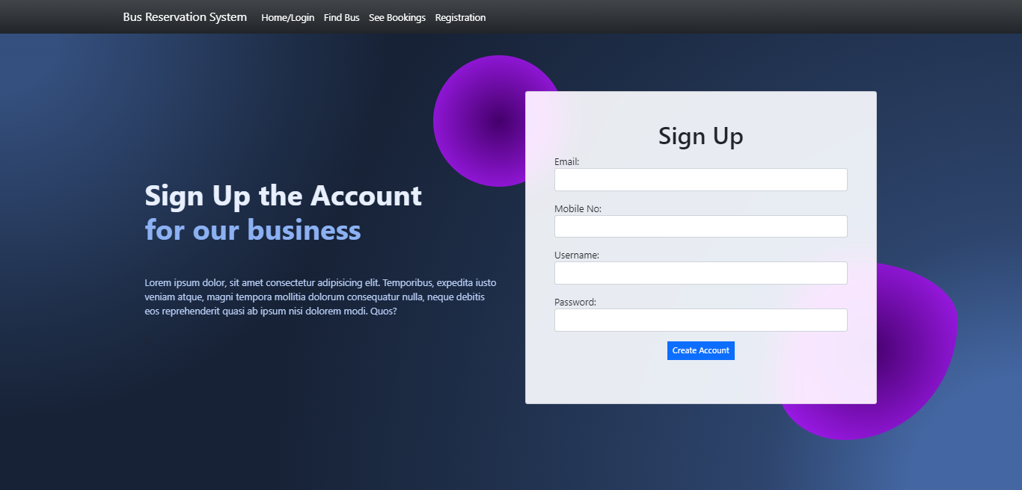
REGISTRATION PAGE

Slide 14
Future Enhancements:
Integrate with other transportation modes for seamless travel.
Implement a feedback system for users to provide reviews.
Enhance accessibility features for users with disabilities.
Introduce QR code or RFID-based ticketing systems.
Promote environmental initiatives for sustainable travel.
Implement IoT sensors for predictive maintenance.

Slide 15
Conclusion
In conclusion, the proposed Bus Reservation System (BRS) offers a comprehensive solution for efficient bus ticket booking and management.
Source :

Slide 16
Thank You!
Notes:
Thank You !!

